Slide 1
Chapter 5
The Laws of Motion

Slide 2
The Laws of Motion
In chapter 2 and 4 the full description of an object motion was done in terms of its position, velocity, and acceleration.
Now we considering what might influence that motion i.e. second important part of mechanics “Dynamics”.
What might cause one object to remain at rest and another object to accelerate?
To answer questions about why the motion of an object will change.
  Forces acting on the object
  The mass of the object
Dynamics describes the relationship between the motion of objects in our everyday world and the forces acting on them
Introduction

Slide 3
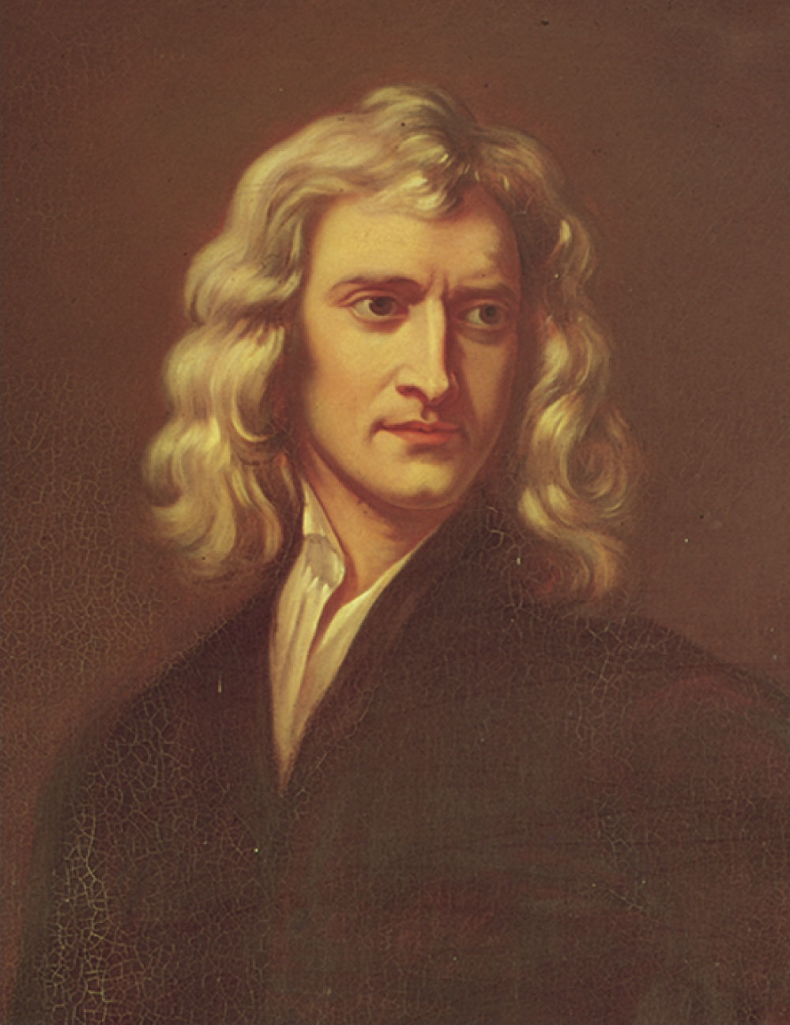
Sir Isaac Newton
1642 – 1727
Formulated basic laws of mechanics
Discovered Law of Universal Gravitation
Invented form of calculus
Many observations dealing with light and optics
Section 5.1

Slide 4
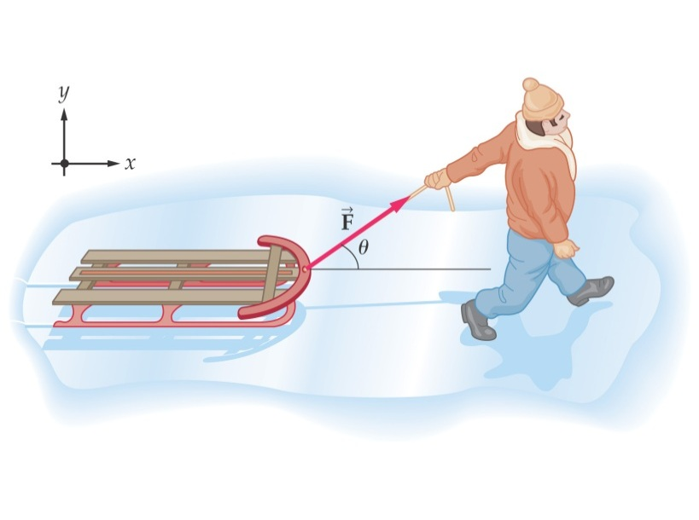
The Concept of Force
Forces in everyday experience
  Push or pull on an object to move it
  Throw or kick a ball.
In these examples the word force refer to an interaction with an object by means of muscular activity and some change in the object’s velocity.
Forces are what cause any change in the velocity of an object.
  Newton’s definition
  A force is that which causes an acceleration
Section 5.1

Slide 5
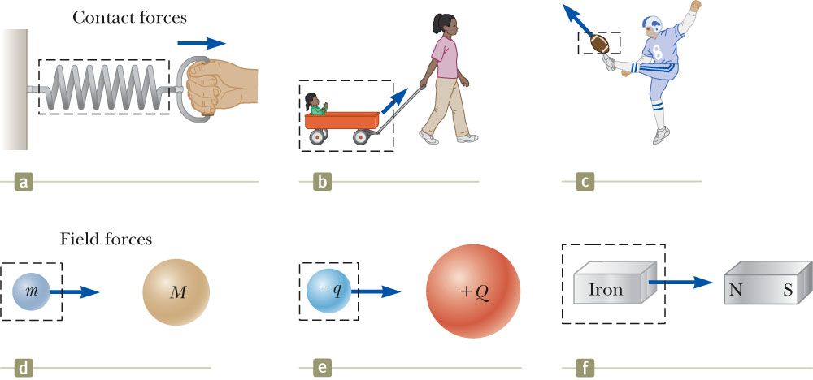
Classes of Forces
Contact forces involve physical contact between two objects
  Examples a, b, c
Field forces does not involve physical contact between two objects they act through empty space
  Examples d, e, f
Section 5.1

Slide 6
Fundamental Forces
Gravitational force
  Between objects
Electromagnetic forces
  Between electric charges
Nuclear force
  Between subatomic particles
Weak forces
  Arise in certain radioactive decay processes
Note: These are all field forces.
Section 5.1

Slide 7
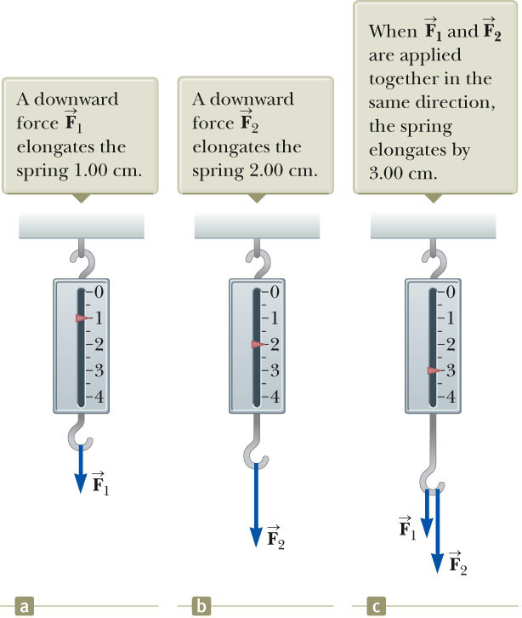

The Vector nature of forces
A spring can be used to calibrate the magnitude of a force.
We can calibrate the spring by defining a reference force as the force that produces a pointer reading of 1.00 cm.
Doubling the force causes double the reading on the spring.
When both forces are applied, the reading is three times the initial reading.
Section 5.1

Slide 8
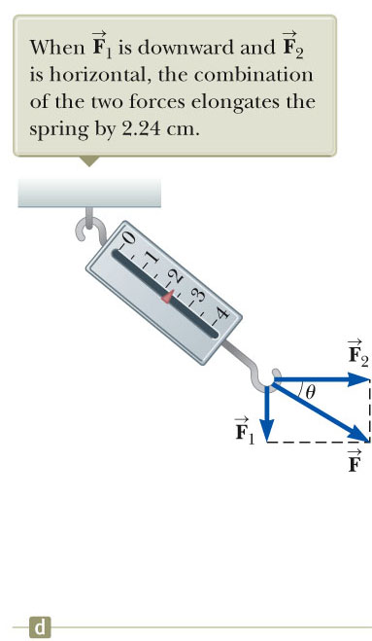


Vector Nature of Forces
Now suppose the two forces are applied simultaneously with downward and horizontal.
The two forces are applied perpendicularly, so in this case, the pointer reads 2.24 cm.
Because forces have been experimentally verified to behave as vectors, you must use the rules of vector addition to obtain the net force on an object.
Section 5.1

Slide 9
Newton’s First Law
In the absence of external forces and when viewed from an inertial reference frame, an object at rest remains at rest and an object in motion continues in motion with a constant velocity (that is, with a constant speed in a straight line).
In other words, when no force acts on an object, the acceleration of the object is zero.
This is also called the law of inertia. It defines a special set of reference frames called inertial frames.
The tendency of an object to resist any attempt to change its velocity is called inertia.
In conclusion an accelerating object must be experiencing a force.
Or force as that which causes a change in motion of an object.
Section 5.2

Slide 10
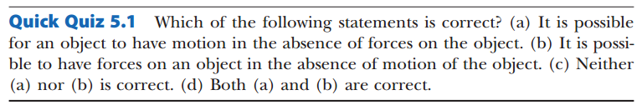

Slide 11
Mass vs. Weight
Mass and weight are two different quantities.
Weight is equal to the magnitude of the gravitational force exerted on the object.
  Weight will vary with location.
Example:
  w_{earth} = 180 Newton ; w_{moon} ~ 30 Newton
  m_{earth} = 2 kg; m_{moon} = 2 kg
Section 5.3

Slide 12
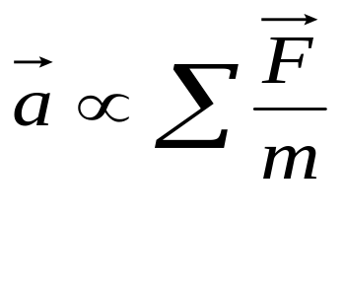
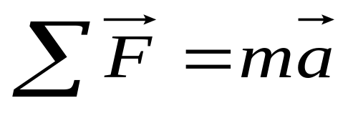
Newton’s Second Law
When viewed from an inertial reference frame, the acceleration of an object is directly proportional to the net force acting on it and inversely proportional to its mass.
Force is the cause of changes in motion, as measured by the acceleration.
    Remember, an object can have motion in the absence of forces.
    Do not interpret force as the cause of motion.
Algebraically,
  With a proportionality constant of 1 and speeds much lower than the speed of light.
Section 5.4

Slide 13
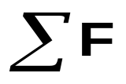


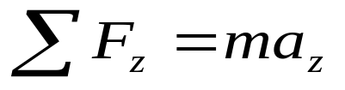
More About Newton’s Second Law
is the net force
  This is the vector sum of all the forces acting on the object.
    May also be called the total force, resultant force, or the unbalanced force.
Newton’s Second Law can be expressed in terms of components:
Remember that ma is not a force.
  The sum of the forces is equated to this product of the mass of the object and its acceleration.
Section 5.4

Slide 14
Units of Force
The SI unit of force is the newton (N).
  1 N = 1 kg·m / s²
The US Customary unit of force is a pound (lb).
  1 lb = 1 slug·ft / s²
1 N ~ ¼ lb
Section 5.4

Slide 15
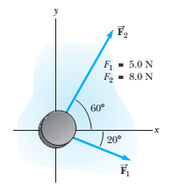
Problem 5.1 An Accelerating Ice Hockey Disk
A hockey disk having a mass of 0.30 kg slides on the horizontal, frictionless surface of an ice rink. Two hockey sticks strike the disk simultaneously, exerting the forces on the disk shown in Figure. The force has a magnitude of 5.0 N, and the force has a magnitude of 8.0 N.
Determine both the magnitude and the direction of the disk’s acceleration.

Slide 16
Conceptual Example 5.3 You Push Me and I’ll Push You
A large man and a small boy stand facing each other on frictionless ice. They put their hands together and push against each other so that they move apart.
Who moves away with the higher speed?
Who moves farther while their hands are in contact?

Slide 17

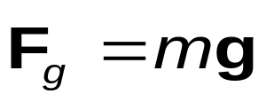
Gravitational Force
The gravitational force, , is the force that the earth exerts on an object.
This force is directed toward the center of the earth.
  From Newton’s Second Law:
Its magnitude is called the weight of the object.
  Weight = F_{g}= mg
Section 5.5

Slide 18
Quick Quiz 5.4
Suppose you are talking by interplanetary telephone to a friend, who lives on the Moon. He tells you that he has just won a newton of gold in a contest. Excitedly, you tell him that you entered the Earth version of the same contest and also won a newton of gold! Who is richer? (a) You are. (b) Your friend is. (c) You are equally rich.

Slide 19


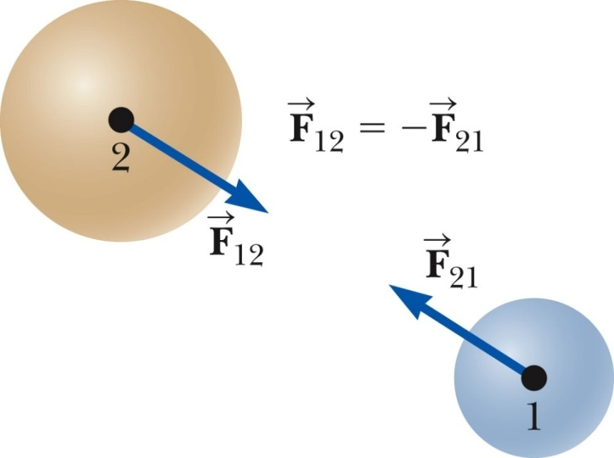
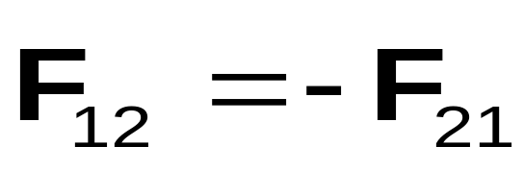

Newton’s Third Law
If two objects interact, the force exerted by object 1 on object 2 is equal in magnitude and opposite in direction to the force exerted by object 2 on object 1.
  Note on notation: is the force exerted by A on B.
  In all cases, the action and reaction forces act on different objects and must be the same type (Gravitational, Electrical, etc.)
Section 5.6

Slide 20
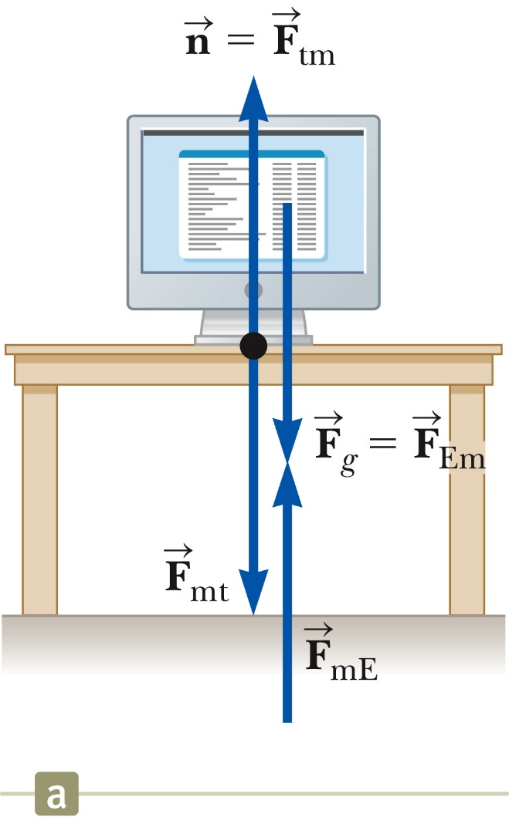
Action-Reaction Examples, 2
When a computer monitor is at rest on a table, the forces acting on the monitor are the normal force n and the gravitational force F_{g}.
The reaction to n is the force F_{mt} exerted by the monitor on the table. The reaction to F_{g} is the force F_{mE} exerted by the monitor on the Earth.
Section 5.6

Slide 21
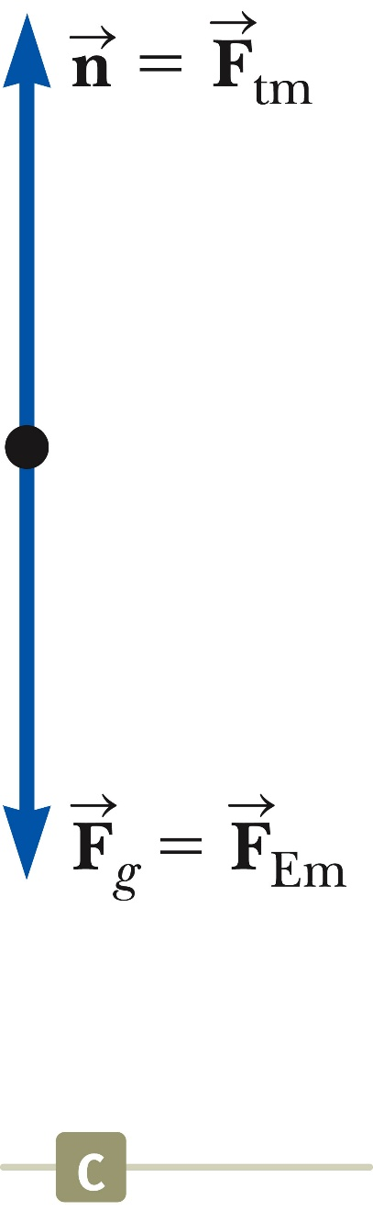
Free Body Diagram
The most important step in solving problems involving Newton’s Laws is to draw the free body diagram (FBD).
Be sure to include only the forces acting on the object of interest.
Include any field forces acting on the object.
Do not assume the normal force equals the weight.
Section 5.6

Slide 22
Analysis Models Using Newton’s Second Law
Assumptions
Objects can be modeled as particles.
Interested only in the external forces acting on the object
Can neglect reaction forces
Initially dealing with frictionless surfaces
Masses of strings or ropes are negligible.
The force the rope exerts is away from the object and parallel to the rope.
When a rope attached to an object is pulling it, the magnitude of that force is the tension in the rope.
Section 5.7

Slide 23
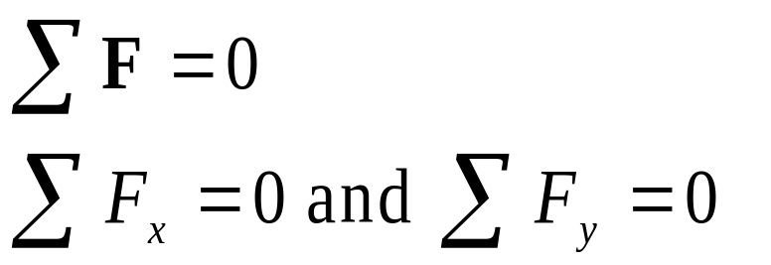
Analysis Model: The Particle in Equilibrium
If the acceleration of an object that can be modeled as a particle is zero, the object is said to be in equilibrium.
The model is the particle in equilibrium model.
Mathematically, the net force acting on the object is zero.
Section 5.7

Slide 24
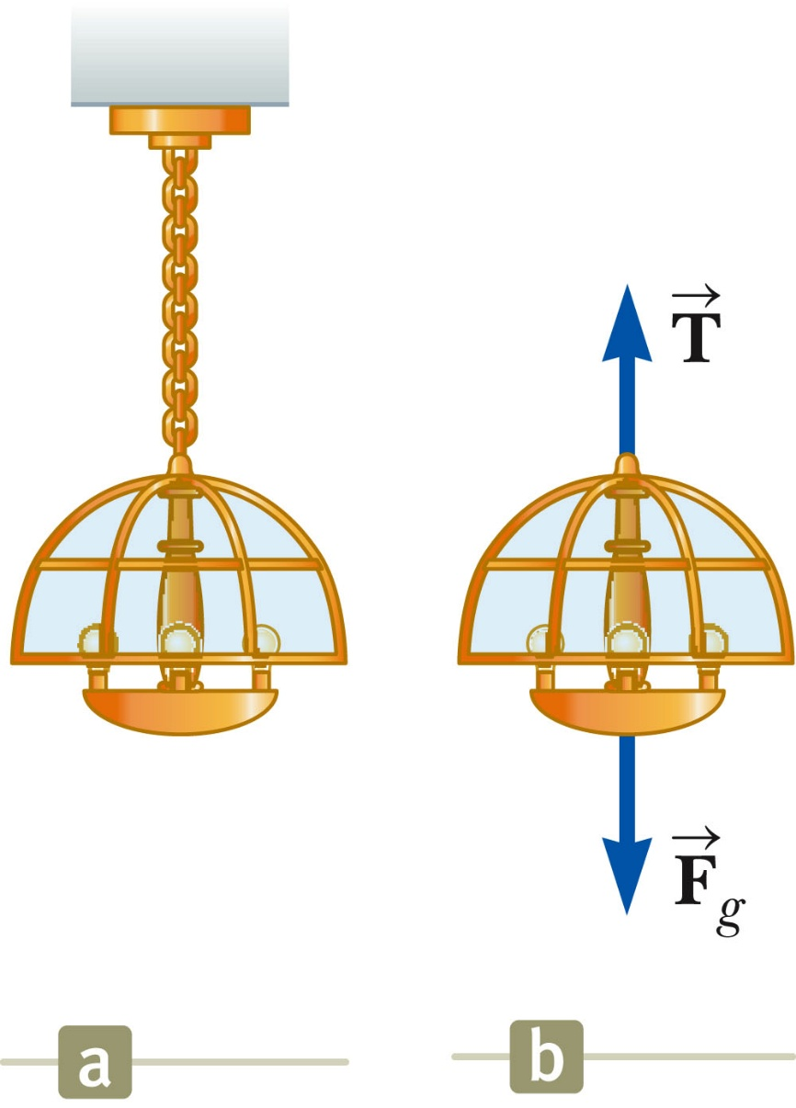
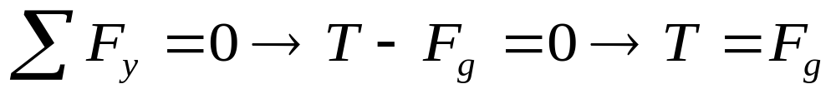
Equilibrium, Example
A lamp is suspended from a chain of negligible mass.
The forces acting on the lamp are:
  the downward force of gravity
  the upward tension in the chain
Applying equilibrium gives
Section 5.7

Slide 25
Analysis Model: The Particle Under a Net Force
If an object that can be modeled as a particle experiences an acceleration, there must be a nonzero net force acting on it.
  Model is particle under a net force model .
Draw a free-body diagram.
Apply Newton’s Second Law in component form.
Section 5.7

Slide 26
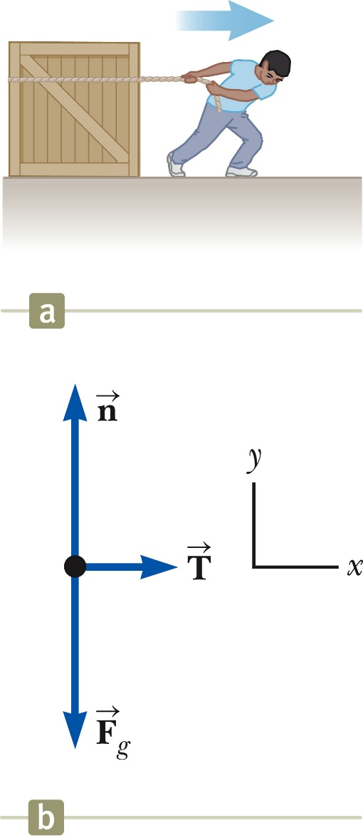





Newton’s Second Law, Example 1
Forces acting on the crate:
  A tension, acting through the rope, is the magnitude of force
  The gravitational force,
  The normal force, , exerted by the floor
  Apply Newton’s Second Law in component form:
Section 5.7

Slide 27
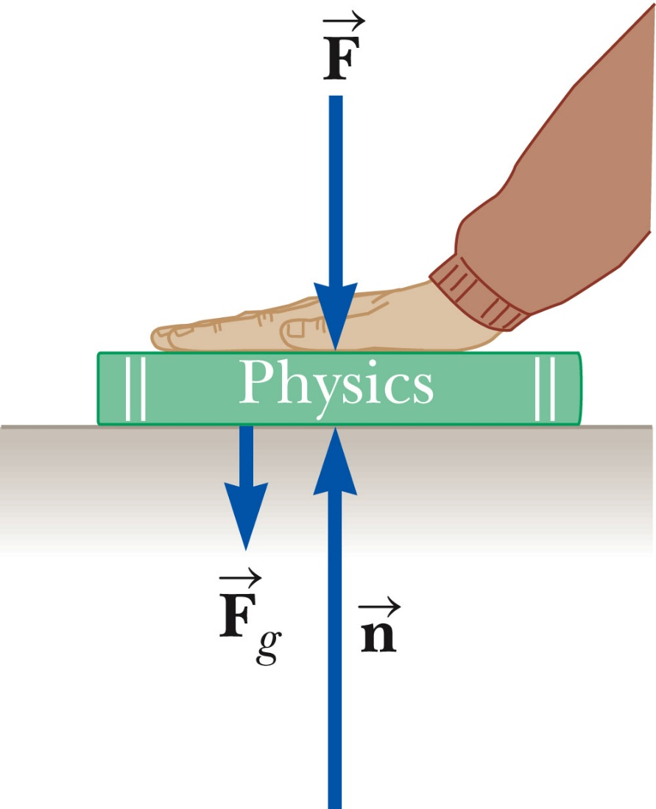
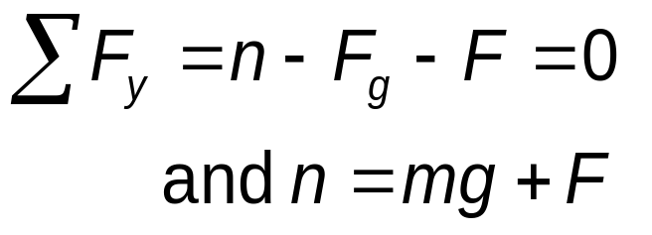

Note About the Normal Force
The normal force is not always equal to the gravitational force of the object.
For example, in this case
may also be less than
Section 5.7

Slide 28
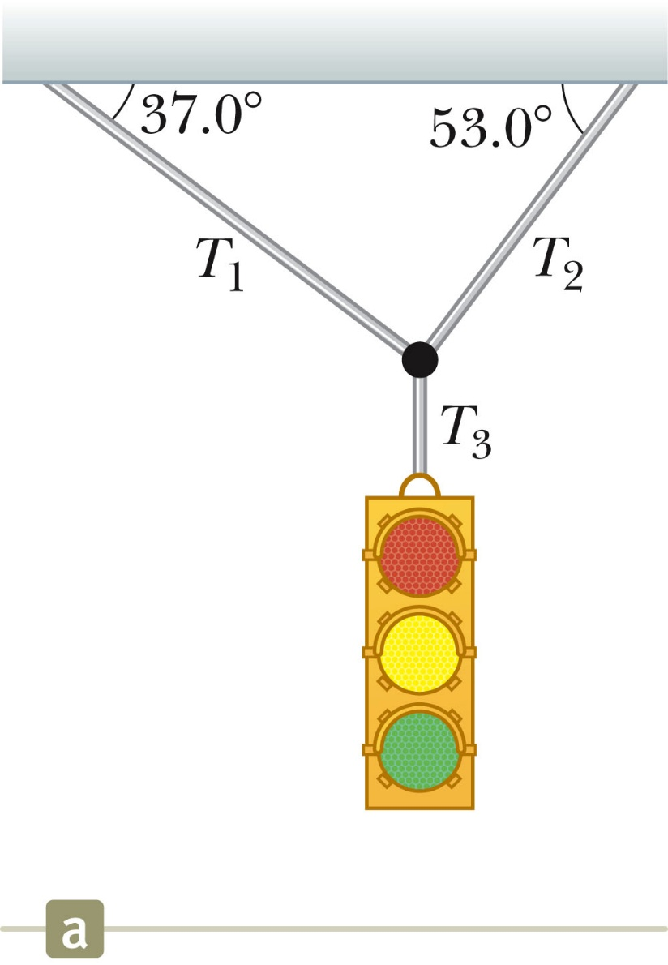
Problem 5.4: Equilibrium
A traffic light weighing 122 N hangs from a cable tied to two other cables fastened to a support, as in Figure. The upper cables make angles of 37.0⁰ and 53.0⁰ with the horizontal. These upper cables are not as strong as the vertical cable, and will break if the tension in them exceeds 100 N.
Will the traffic light remain hanging in this situation, or will one of the cables break?
What If? Suppose the two angles in Figure are equal. What would be the relationship between T₁ and T₂?
Section 5.7

Slide 29
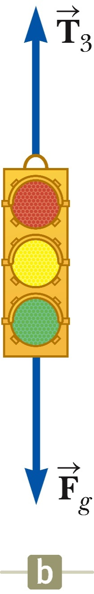
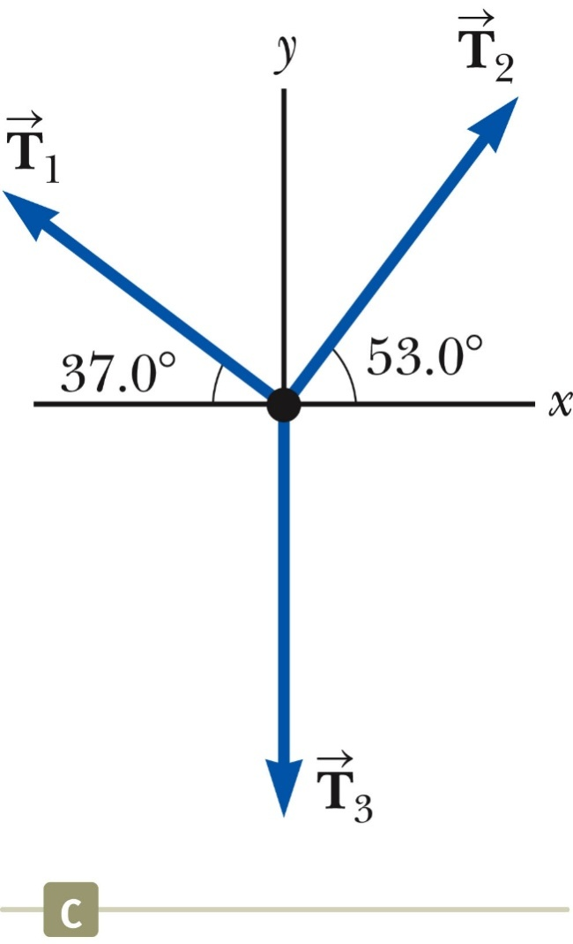
Problem 5.4: Equilibrium
Free Body Diagram of our problem
Equilibrium model will be apply
Resolve forces into horizontal and vertical components
Section 5.7

Slide 30
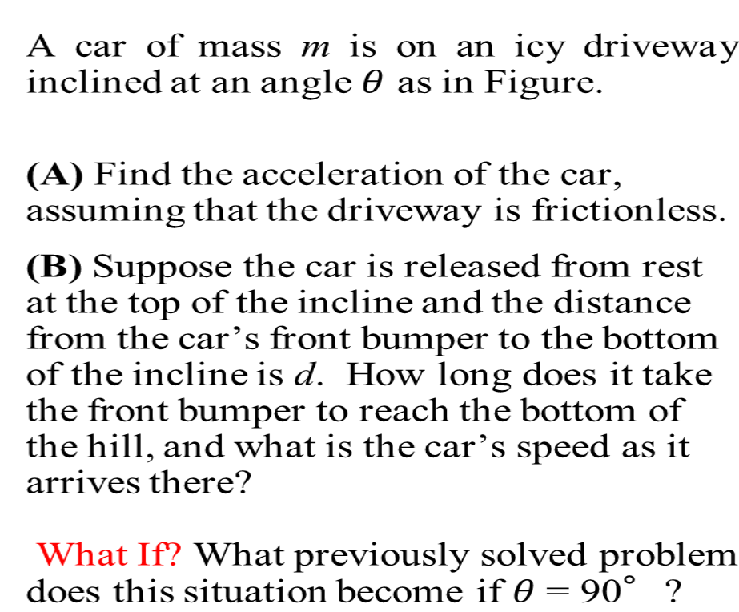
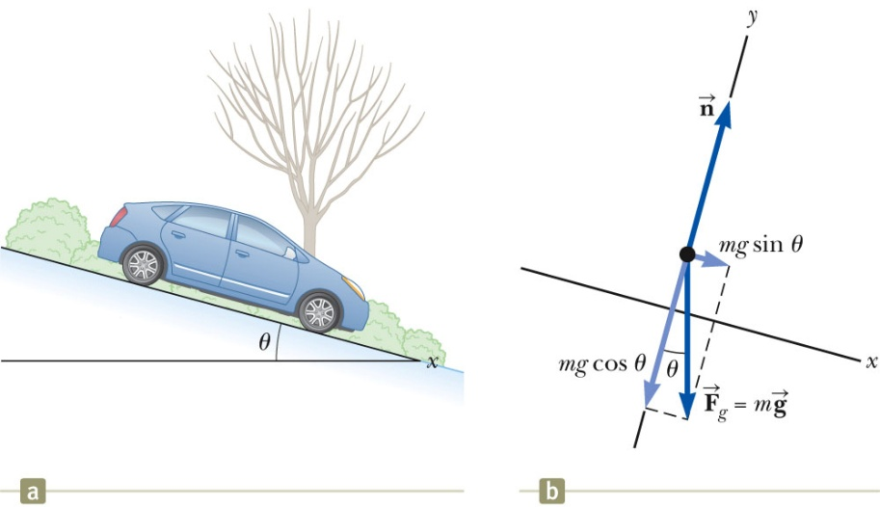
Problem 5.6 The Runway Car
Section 5.7

Slide 31
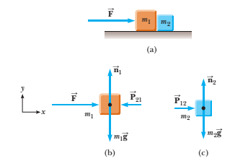
Problem 5.7: One Block Pushes Another
Two blocks of masses m₁ and m₂, with m₁ > m₂, are placed in contact with each other on a frictionless, horizontal surface as in Active Figure.
A constant horizontal force is applied to m₁ as shown.
(a) Find the magnitude of the acceleration of the system.
(b) Determine the magnitude of the contact force between the two blocks.
Section 5.7

Slide 32
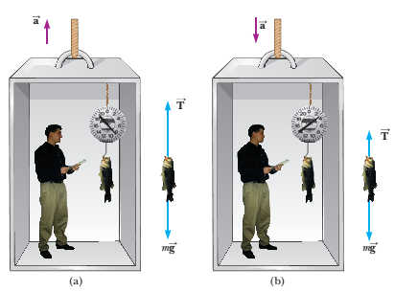
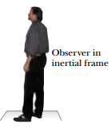
Problem 5.8: Apparent weight versus true weight
A person weighs a fish of mass m on a spring scale attached to the ceiling of an elevator as illustrated in Figure.
(A) Show that if the elevator accelerates either upward or downward, the spring scale gives a reading that is different from the weight of the fish.
(B) Evaluate the scale readings for a 40.0-N fish if the elevator moves with an acceleration a_{y} =±2.00 m/s².

Slide 33
Problem 5.8 Weighing a Fish in an Elevator
What If? Suppose the elevator cable breaks and the elevator and its contents are in free-fall .What happens to the reading on the scale?
Answer: If the elevator falls freely, its acceleration is ay = -g. We see from (2)
T = m(g-ay), that the scale reading T is zero in this case; that is, the fish appears to be weightless.

Slide 34
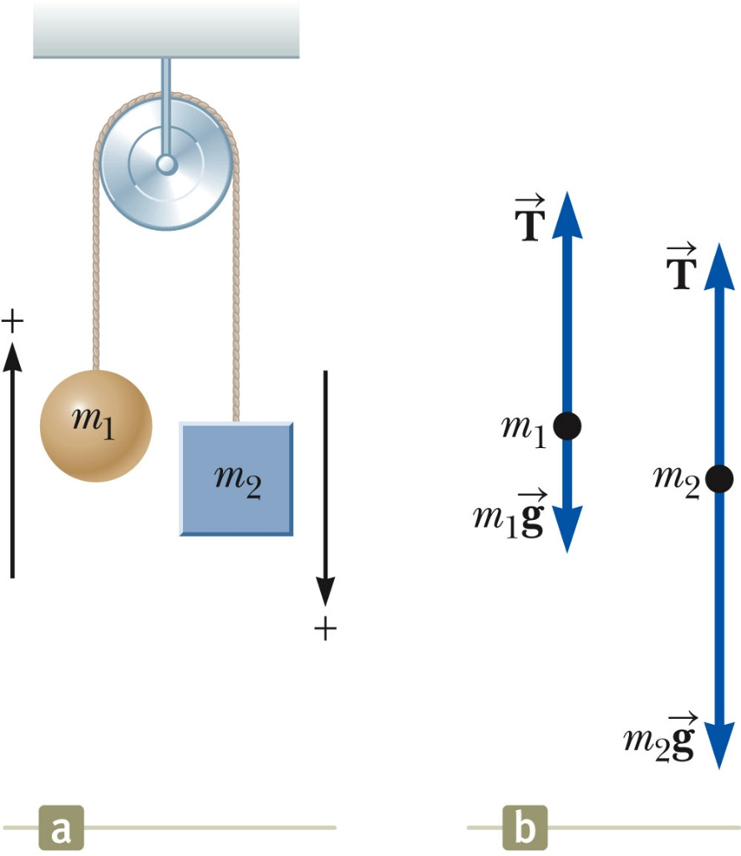
Problem 5.9: The Atwood’s Machine
When two objects of unequal mass are hung vertically over a frictionless pulley of negligible mass as in Active Figure, the arrangement is called an Atwood machine.
The device is sometimes used in the laboratory to calculate the value of g.
Determine the magnitude of the acceleration of the two objects and the tension in the lightweight cord.
Section 5.7

Slide 35
Problem 5.9: The Atwood’s Machine
What If? (A) Describe the motion of the system if the objects have equal masses, that is, m₁= m₂.
(B) Describe the motion of the system if one of the masses is much larger than the other, m₁>> m₂
Section 5.7

Slide 36
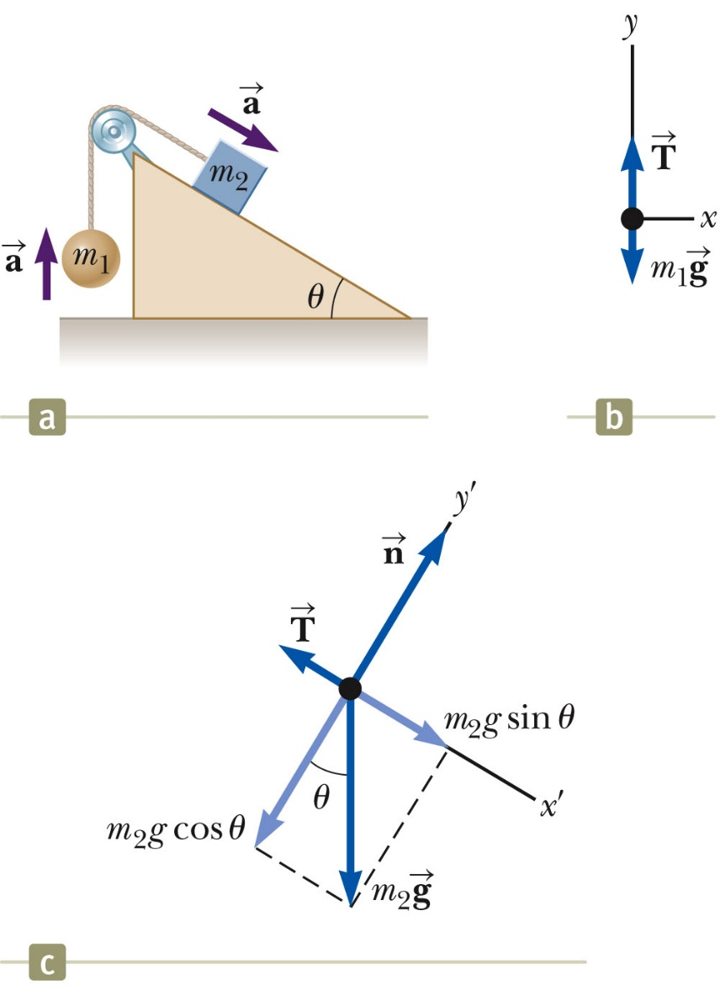
Problem 5.10: Acceleration of two Objects connected by a cord
A ball of mass m₁ and a block of mass m₂ are attached by a lightweight cord that passes over a frictionless pulley of negligible mass as in Figure.
The block lies on a frictionless incline of angle θ.
Find the magnitude of the acceleration of the two objects and the tension in the cord.
Section 5.7

Slide 37
Problem 5.10:
What If? (A) What happens in this situation if the angle θ = 90° ?
(B) What happens if the mass m₁= 0?
Section 5.7

Slide 38
Forces of Friction
When an object is in motion on a surface or through a viscous medium, there will be a resistance to the motion. This is due to the interactions between the object and its environment.
This resistance is called the force of friction.
Forces of friction are very important in our everyday lives. They allow us to walk or run and are necessary for the motion of wheeled vehicles.

Slide 39
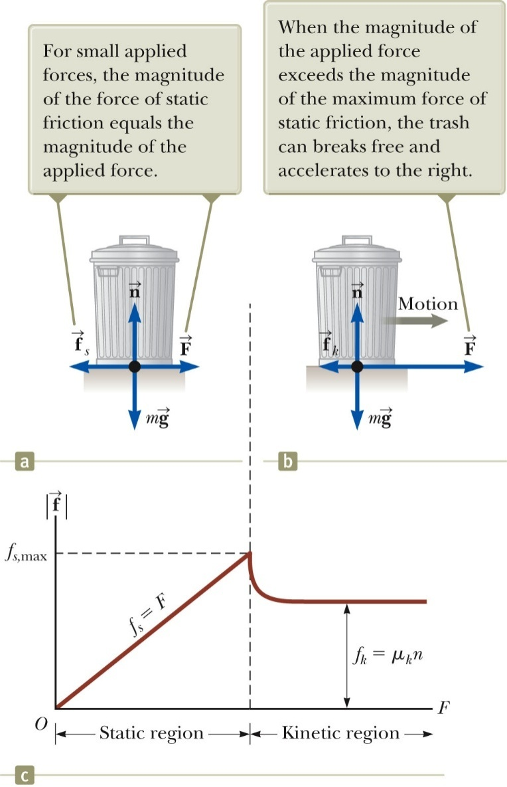





If we apply an external horizontal force F to the trash can, acting to the right, the trash can remains stationary if F is small. The force that counteracts F and keeps the trash can from moving acts to the left and is called the force of static friction . As long as the can is not moving .
Thus, if F is increased , also increased and vise versa.
If we increase the magnitude of F, as in figure (b), the trash can then eventually slips. When the can trash is on the verge of slipping , has its maximum , as shown in figure.
When F exceeds , the trash can moves and accelerates to the right, when the trash can is in motion, the friction force is less than , as can be viewed.
The force of friction experienced by an object in motion is called force of kinetic friction

Slide 40
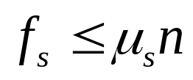


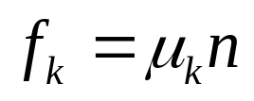

Forces of Friction
Experimentally, to a good approximation, both, and are proportional to the magnitude of the normal force.
The magnitude of static friction in between any two surfaces in contact can have
is the coefficient of static friction
For static friction, the equals sign is holds only when the surfaces of the verge of slipping that is when
  Inequality holds for static friction if the surfaces are not on the verge of slipping.
  The magnitude of kinetic friction acting between two surfaces is ,
  , is called coefficient of kinetic friction
Section 5.8

Slide 41
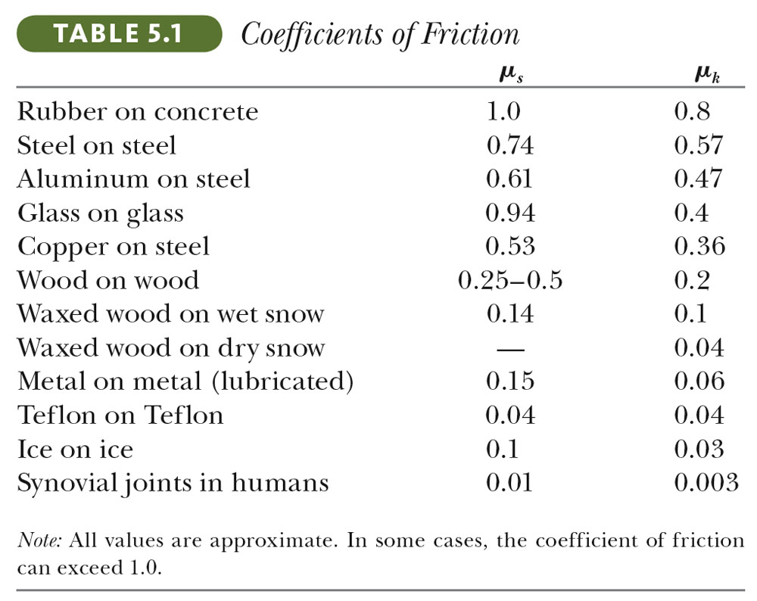
Some Coefficients of Friction
Section 5.8

Slide 42
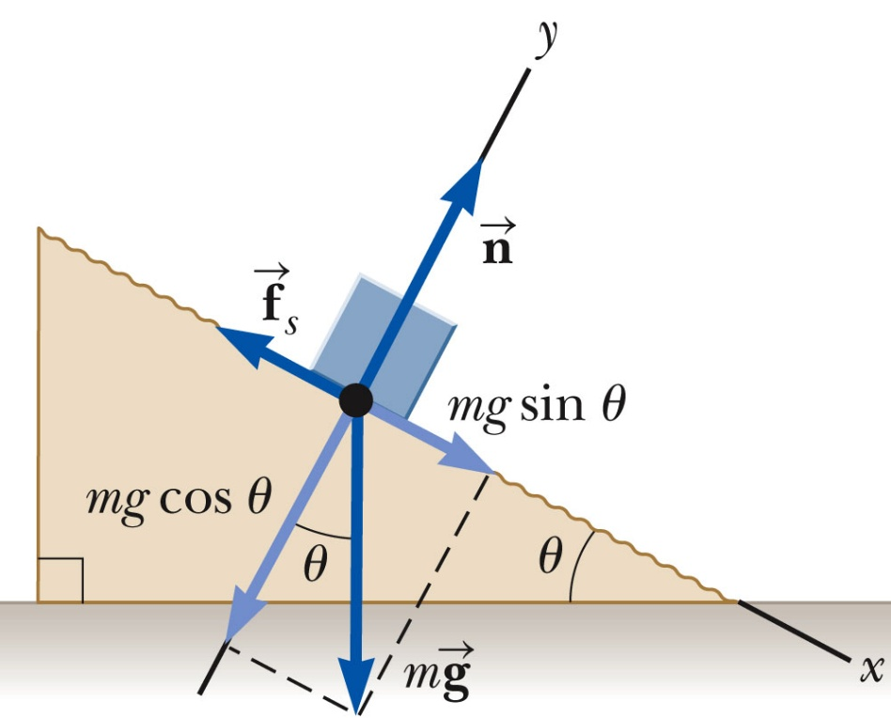


Friction Problem 1
  The following is a simple method of measuring coefficients of friction: Suppose a block is placed on a rough surface inclined relative to the horizontal, as shown in Figure.
  The incline angle is increased until the block starts to move. Show that by measuring the critical angle at which this slipping just occurs, we can obtain .
Section 5.8

Slide 43
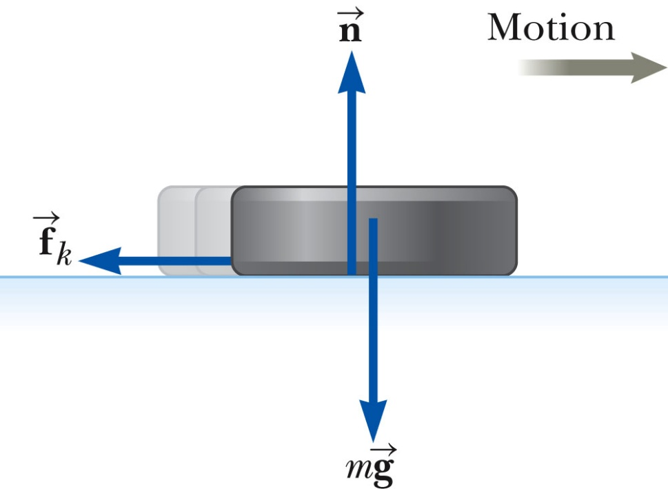
Friction, Problem 2
A hockey disk on a frozen pond is given an initial speed of 20.0 m/s. If the disk always remains on the ice and slides 115 m before coming to rest, determine the coefficient of kinetic friction between the disk and ice.
Section 5.8

Slide 44
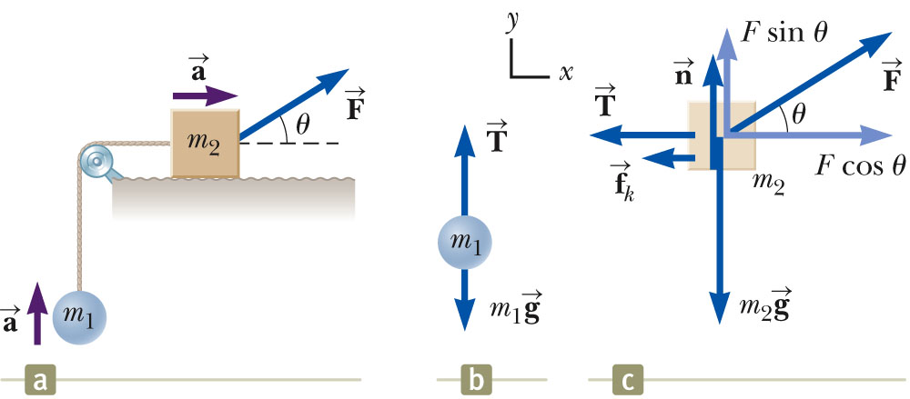
Friction, Problem 3
A block of mass m₁ on a rough, horizontal surface is connected to a ball of mass m₂ by a light weight cord over a lightweight, frictionless pulley, as shown in Figure. A force of magnitude F at an angle θ with the horizontal is applied to the block as shown. The coefficient of kinetic friction between the block and surface is μ_{k}. Determine the magnitude of the acceleration of the two objects
Section 5.8

